Slide 1
AI in Smart Cities
General Applications of AI
Focus on Traffic, Energy & Waste Management

Slide 2
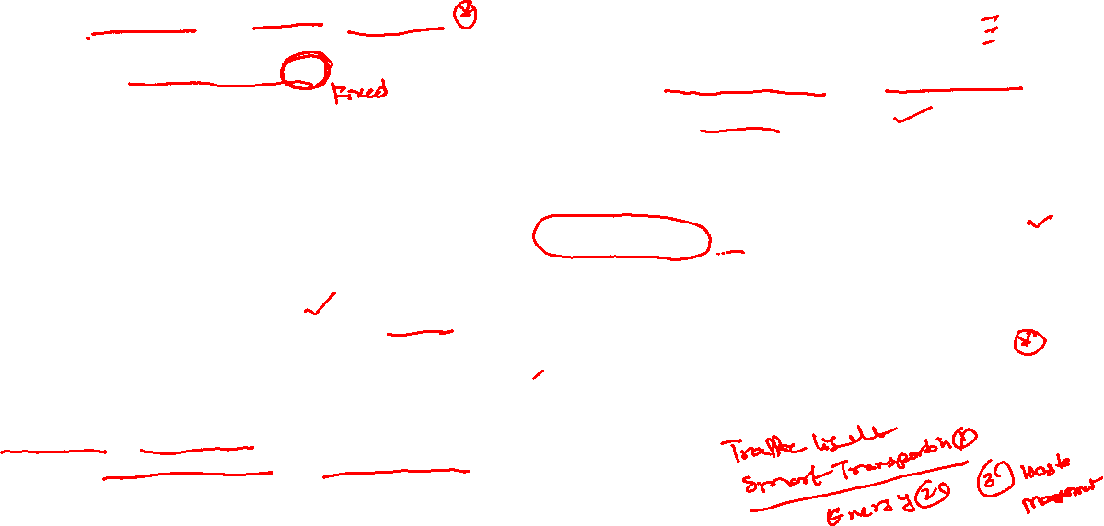

Applications of AI in Smart cities
Adaptive Traffic Control: Surtrac, Pittsburgh (USA)
Use Case: Real-time traffic light optimization using AI Reference: MIT News – AI tackles urban traffic congestion
AI in Bus Scheduling: SMRT Singapore
Use Case: Predictive analytics for dynamic scheduling Reference: GovTech Singapore – AI in public transport
Smart Grid Optimization: FlexiGrid, Netherlands
Use Case: AI to balance solar/wind with energy demand Reference: EU FlexiGrid Project
Surveillance & Public Safety: Dubai, UAE
Use Case: AI facial recognition + predictive policing Reference: Smart Dubai Government
Environmental Monitoring: Beijing, China
Use Case: IBM’s AI-based air pollution forecasting Reference: IBM Research China – AI for Clean Air
e-Governance Chatbots: Estonia
Use Case: AI bots for taxation, healthcare, and licensing Reference: e-Estonia Briefing Centre
Urban Planning Optimization: Helsinki, Finland
Use Case: AI for zoning, housing, and mobility planning Reference: Helsinki Smart City Strategy
Smart Waste Management: Barcelona, Spain
Use Case: AI + IoT smart bins + dynamic routing Reference: SmartSantander Project Report

Slide 3
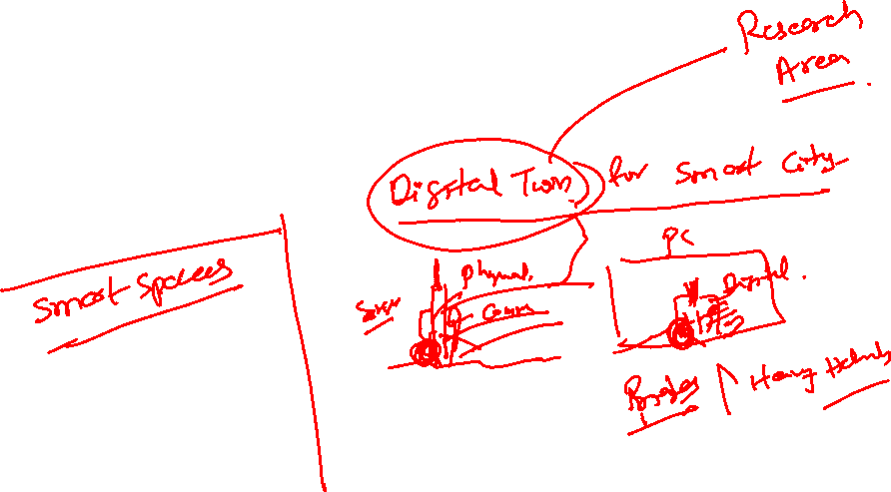
Outline
AI in Traffic Signal Optimization
Real-Time Traffic Prediction & Smart Transportation
Energy Efficiency with AI
AI in Waste Management
Use Cases

Slide 4
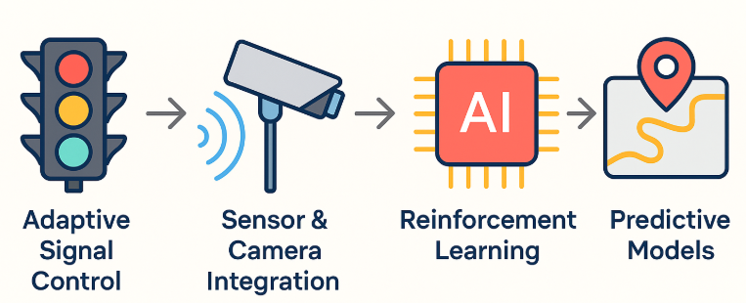
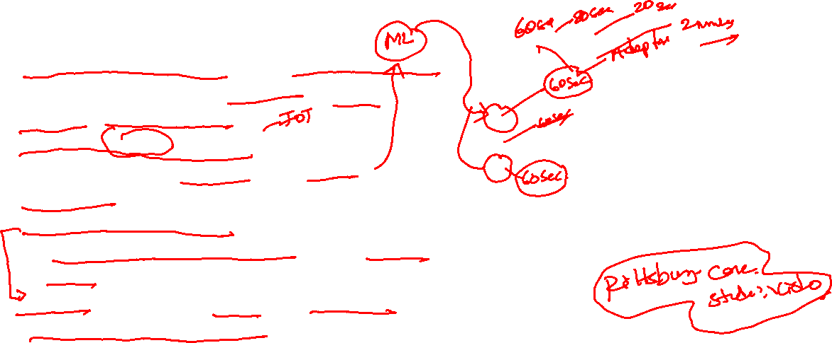
AI in Traffic Signal Optimization
Adaptive Signal Control using machine learning algorithms that adjust light cycles based on real-time traffic patterns.
Sensor & Camera Integration to gather live data at intersections (vehicle count, speed, congestion).
Reinforcement Learning or Rule-Based AI to minimize average vehicle delay and maximize flow efficiency.
Predictive Models to anticipate congestion and dynamically reroute traffic.

Slide 5
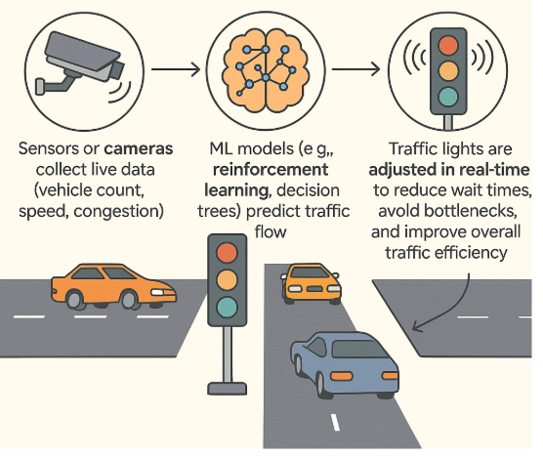
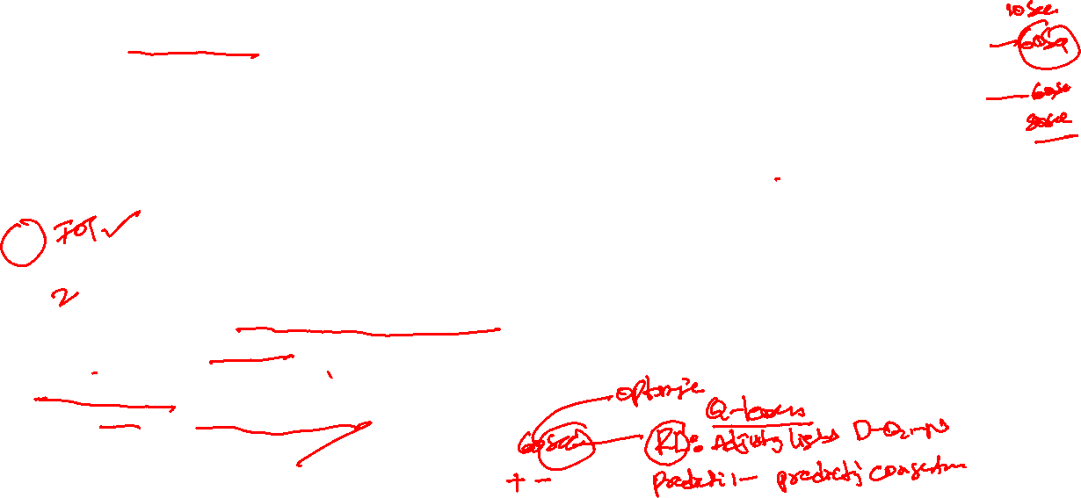
AI in Traffic Signal Optimization
Adaptive Signal Control using Machine Learning
Adaptive signal control uses machine learning algorithms to dynamically adjust traffic light timings based on real-time traffic flow, vehicle density, and historical patterns.
How it works:
Sensors or cameras collect live data (vehicle count, speed, congestion).
ML models (e.g., reinforcement learning, decision trees) predict traffic flow.
Traffic lights are adjusted in real-time to reduce wait times, avoid bottlenecks, and improve overall traffic efficiency.

Slide 6
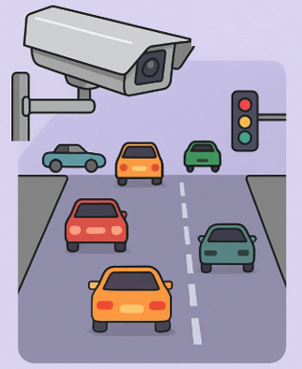
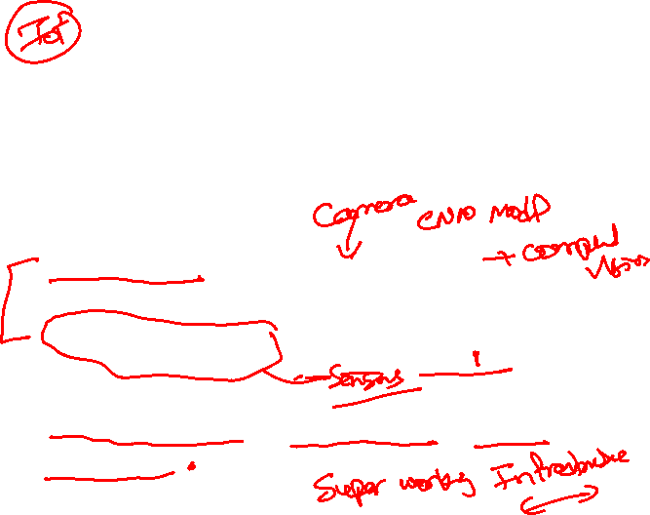
AI in Traffic Signal Optimization
Sensor & Camera Integration for Traffic AI
To collect real-time traffic data essential for adaptive signal control and smart mobility systems.
Data Collected:
Vehicle count: Number of vehicles approaching or waiting at an intersection
Speed estimation: Average speed of moving traffic
Congestion level: Queue length, density, and dwell time

Slide 7
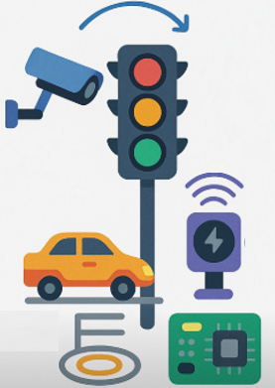
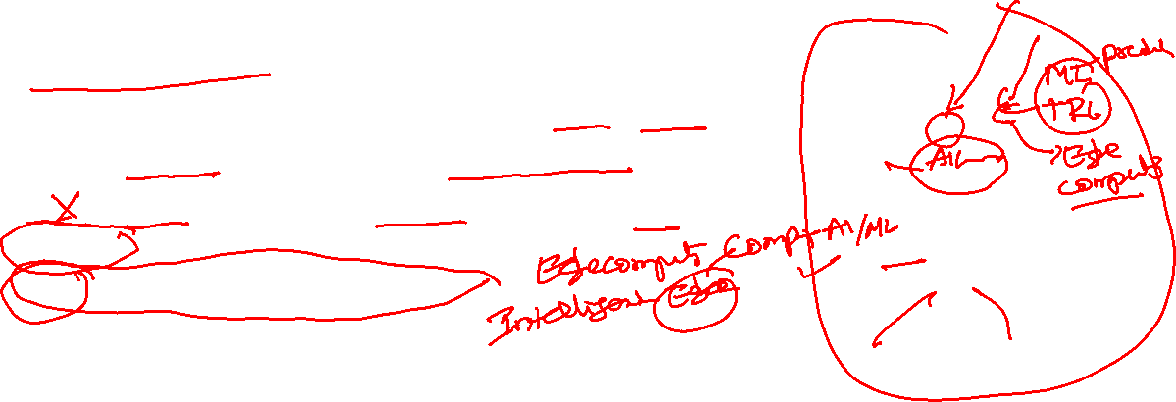
AI in Traffic Signal Optimization
Sensor & Camera Integration for Traffic AI
Technologies Used:
CCTV / IP Cameras with computer vision (YOLO, OpenCV)
Inductive Loop Sensors embedded in road surfaces
Radar & LiDAR Sensors for object detection and speed tracking
Edge Devices for on-site ML inference
Integration Outcome:
Enables real-time analytics for traffic pattern detection
Supports adaptive traffic light timing based on live input
Helps in incident detection (e.g., stalled vehicle, red-light running)

Slide 8
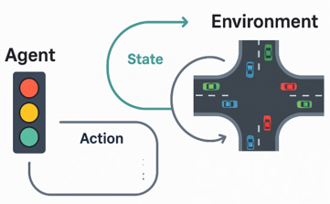
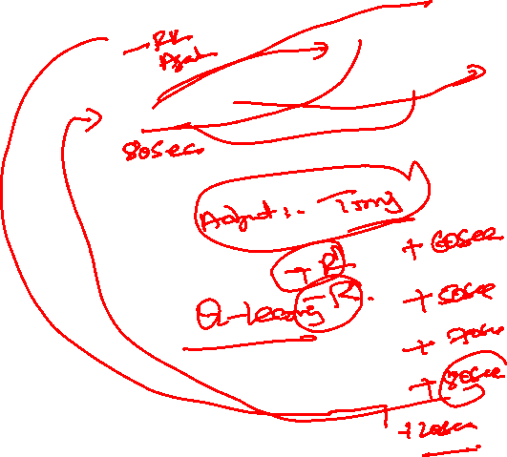
AI in Traffic Signal Optimization
Reinforcement Learning or Rule-Based AI for Traffic Optimization
To dynamically control traffic signals in a way that minimizes average vehicle delay and maximizes intersection throughput.
Reinforcement Learning Approach
Agent: The traffic controller (e.g., traffic light).
Environment: The intersection with incoming vehicles.
State: Current traffic density, queue length, waiting times.
Action: Change in signal phase/duration (e.g., green → red).
Reward: Negative of average waiting time or queue length.

Slide 9
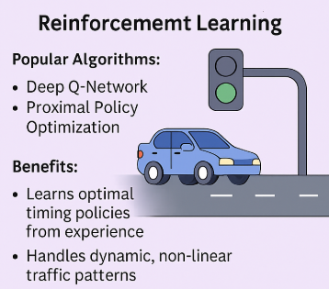
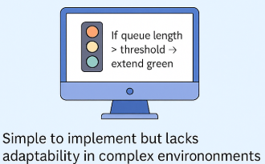
AI in Traffic Signal Optimization
Reinforcement Learning or Rule-Based AI for Traffic Optimization
Popular Algorithms:
Deep Q-Network, Proximal Policy Optimization
Benefits:
Learns optimal timing policies from experience
Handles dynamic, non-linear traffic patterns
Rule-Based AI Approach: Predefined if-then rules based on sensor inputs Example: If queue length > threshold → extend green phase
Simple to implement but lacks adaptability in complex environments
Use Case: RL is suitable for high-traffic, adaptive cities; rule-based works for low-complexity, fixed-pattern roads.

Slide 10
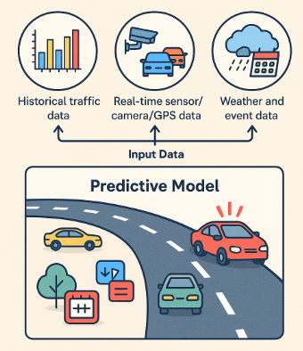
AI in Traffic Signal Optimization
Predictive Models for Traffic Congestion and Rerouting
To forecast traffic congestion before it occurs and enable proactive rerouting of vehicles to reduce delays and distribute flow efficiently.
How Predictive Models Work:
Input Data:
Historical traffic data (volume, speed, incidents)
Real-time sensor/camera/GPS data
Weather and event data (e.g., holidays, sports)

Slide 11
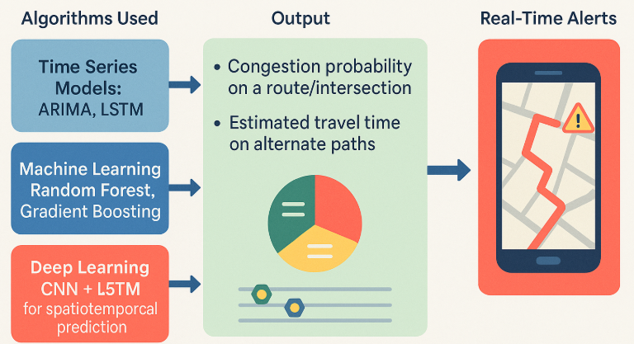
AI in Traffic Signal Optimization
Predictive Models for Traffic Congestion and Rerouting
Algorithms Used:
Time Series Models: ARIMA, LSTM
Machine Learning: Random Forest, Gradient Boosting
Deep Learning: CNN + LSTM for spatiotemporal prediction
Output:
Congestion probability on a route/intersection
Estimated travel time on alternate paths
Real-time alerts for rerouting decisions

Slide 12
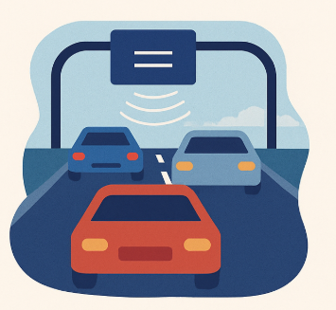
Real-Time Traffic Prediction & Smart Transportation
Real-Time Traffic Prediction
Combines historical traffic data with real-time inputs from:
Road sensors (loop detectors, radar)
GPS data from vehicles and apps
Weather and event-based inputs
AI Models Used:
LSTM (Long Short-Term Memory) for time-series prediction
Random Forest & Gradient Boosting for feature-based modeling
CNN-LSTM hybrids for spatial + temporal learning.

Slide 13
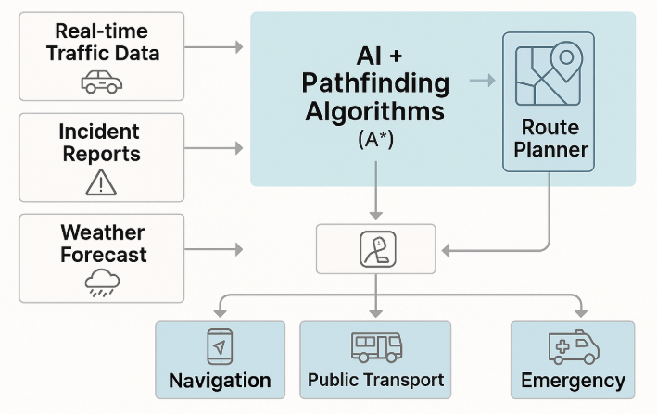
Real-Time Traffic Prediction & Smart Transportation
Dynamic Route Optimization
How It Works:
Combines AI models with graph-based pathfinding algorithms:
A* (A-star), Dijkstra, and Real-Time Shortest Path
Continuously updates route plans based on:
Live traffic congestion
Accidents or road closures
Demand peaks or weather conditions

Slide 14
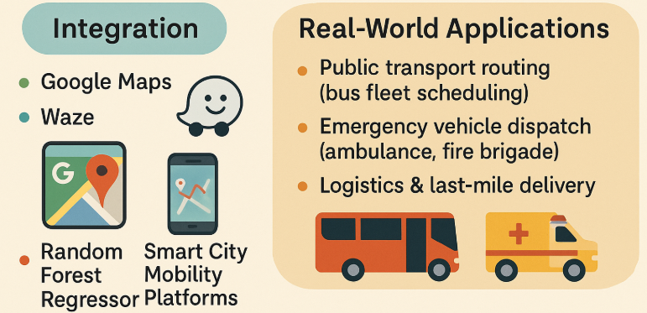
Real-Time Traffic Prediction & Smart Transportation
Dynamic Route Optimization
Integration:
Powers navigation systems like:
Google Maps
Waze AI
Smart City Mobility Platforms
Real-World Applications:
Public transport routing (bus fleet scheduling)
Emergency vehicle dispatch (ambulance, fire brigade)
Logistics & last-mile delivery

Slide 15
Real-Time Traffic Prediction & Smart Transportation
Barcelona, Spain: Smart Transportation Barcelona has implemented various smart city initiatives, focusing on transportation and waste management to enhance urban living.
Sensors:
Traffic Sensors: Inductive loop sensors, radar sensors, and infrared sensors
Parking Sensors: Magnetic sensors, ultrasonic sensors, and camera-based systems.
Environmental Sensors: Air quality sensors and noise sensors
Public Transportation Sensors:
Smart Bin Sensors: Ultrasonic fill-level sensors.
Public Transportation sensors: GPS trackers, passenger counting sensors, and accelerometers
RFID Sensors: Radio-frequency identification tags and readers
Weight Sensors: Type: Load cells and strain gauges

Slide 16
Real-Time Traffic Prediction & Smart Transportation
Traffic Prediction Models:
Type: Time series forecasting models, such as ARIMA, LSTM (Long Short-Term Memory), and Prophet.
Function: Predict traffic flow and congestion patterns.
Application: Optimize traffic light timing, provide real-time traffic updates, and suggest alternative routes to drivers
Input Features:
Historical traffic flow data (vehicle counts, speed, etc.)
Time of day (hour, minute)
Day of the week
Weather conditions (temperature, precipitation, visibility)
Special events (concerts, sports events, public holidays)
Road construction or accidents
GPS coordinates of sensors
Labels: Predicted traffic flow and Predicted congestion levels

Slide 17
Real-Time Traffic Prediction & Smart Transportation
Traffic Prediction Example:
Input Features:
Historical traffic flow: 150 vehicles/hour
Time of day: 8 AM
Day of the week: Monday
Weather: Clear
GPS coordinates: (41.3851, 2.1734)
Label:
Predicted traffic flow: 200 vehicles/hour

Slide 18

Real-Time Traffic Prediction & Smart Transportation
Parking Availability Prediction Models:
Type: Classification and regression models, such as Random Forest, Support Vector Machines (SVM), and Gradient Boosting.
Function: Predict the availability of parking spaces.
Application: Provide real-time parking availability information to drivers and optimize parking space usage.
Input Features:
Historical parking occupancy data
Time of day
Day of the week
Nearby events (public gatherings, sports events)
Weather conditions
GPS coordinates of parking space
Labels: Predicted parking availability (number of available spaces)

Slide 19
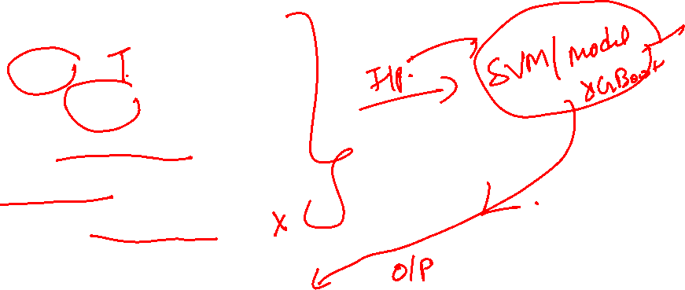
Real-Time Traffic Prediction & Smart Transportation
Parking Availability Prediction Models:
Input Features:
Historical parking occupancy: 80%
Time of day: 6 PM
Day of the week: Friday
Nearby event: Football match
Weather: Partly cloudy
GPS coordinates: (41.3809, 2.1228)
Label:
Predicted parking availability: 20 spaces

Slide 20

Real-Time Traffic Prediction & Smart Transportation
Public Transportation Demand Prediction Models:
Type: Neural networks, including RNNs (Recurrent Neural Networks) and LSTM.
Function: Predict passenger demand on public transportation systems.
Application: Optimize schedules and routes for buses, trams, and metro systems based on predicted demand.
Input Features:
Historical passenger count data
Time of day
Day of the week
Weather conditions
Events affecting public transportation (concerts, parades)
GPS coordinates of stops and routes
Labels:
Predicted passenger count
Predicted demand levels (e.g., low, medium, high)

Slide 21

Energy Efficiency with AI
Smart Grid Optimization using Machine Learning
AI models continuously adjust power distribution based on:
Demand prediction
Real-time sensor feedback
Renewable input variability (e.g., solar, wind)
Enables demand-response systems, automatic load shifting, and peak shaving
Reduces wastage and ensures stable energy delivery

Slide 22
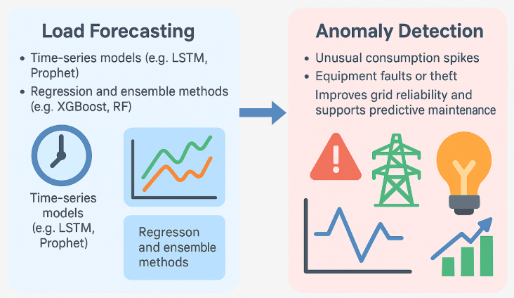
Energy Efficiency with AI
Load Forecasting & Anomaly Detection
Short-term and long-term forecasting of energy demand using:
Time-series models (e.g., LSTM, Prophet)
Regression and ensemble methods (e.g., XGBoost, RF)
Anomaly detection to flag:
Unusual consumption spikes
Equipment faults or theft
Improves grid reliability and supports predictive maintenance

Slide 23
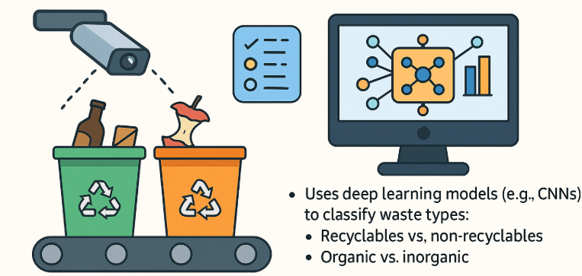
AI in Waste Management
Waste Classification using Computer Vision
Uses deep learning models (e.g., CNNs) to classify waste types:
Recyclables vs. non-recyclables
Organic vs. inorganic
Applied via smart cameras at bins or on sorting lines
Helps automate waste segregation, improving recycling rates and reducing manual labor

Slide 24
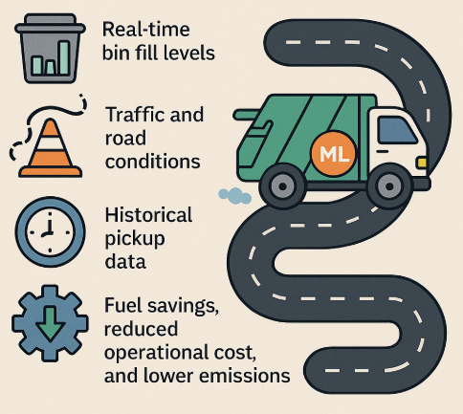
AI in Waste Management
Route Optimization for Garbage Collection
ML algorithms optimize waste truck routes by considering:
Real-time bin fill levels
Traffic and road conditions
Historical pickup data
Results in fuel savings, reduced operational cost, and lower emissions

Slide 25
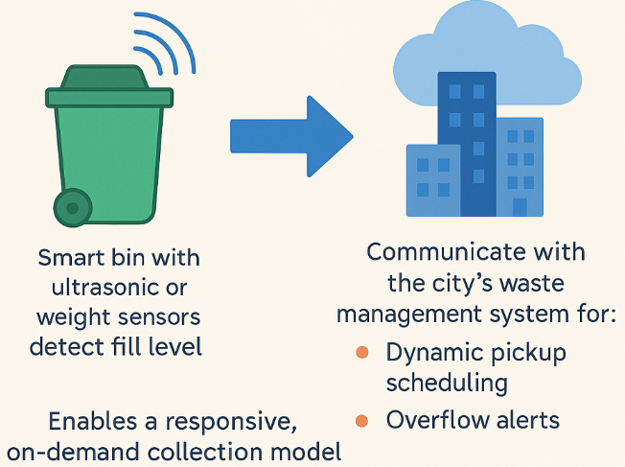
AI in Waste Management
Sensor-Driven Bin Monitoring
Smart bins with ultrasonic or weight sensors detect fill level
Communicate with the city’s waste management system for:
Dynamic pickup scheduling
Overflow alerts
Enables a responsive, on-demand collection model

Slide 26
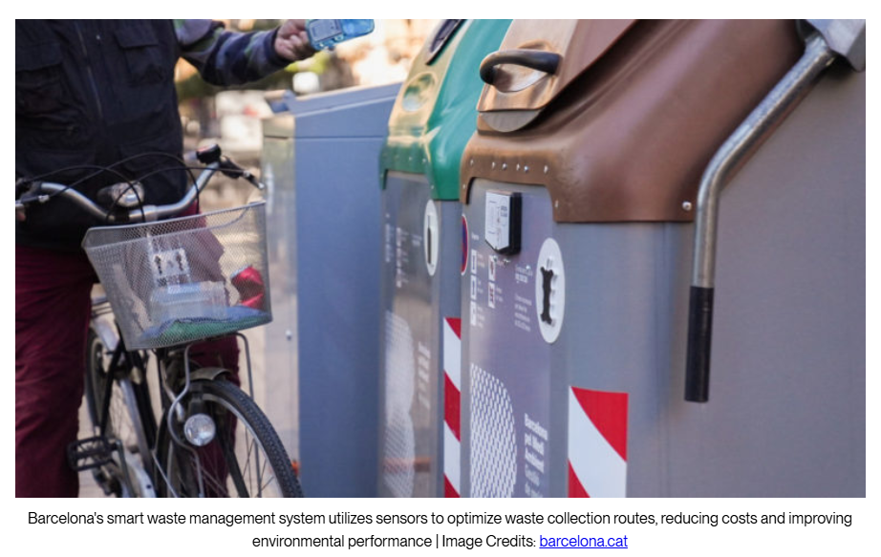
AI in Waste Management: Barcelona’s Smart Waste Management

Slide 27
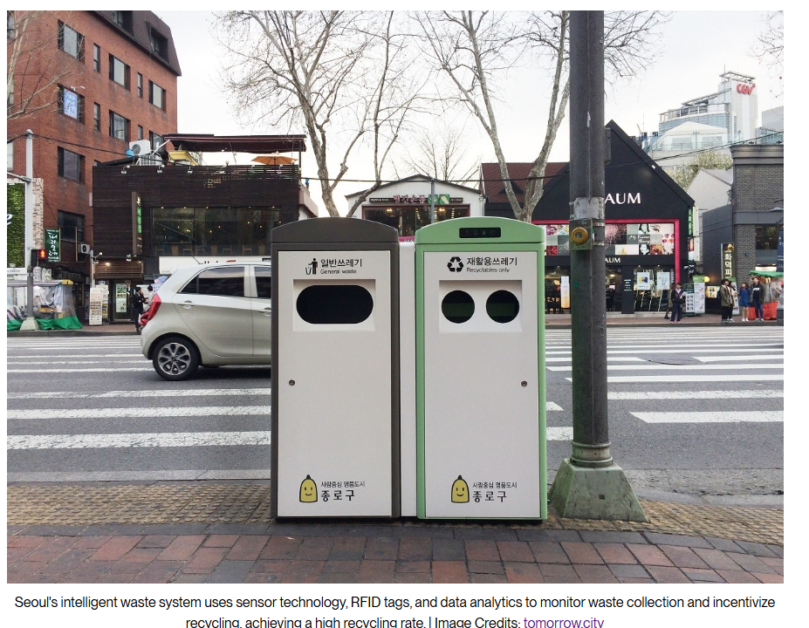
AI in Waste Management: Seoul’s Smart Waste Management

Slide 28

AI in Waste Management
Waste Management ML Models
Fill-Level Prediction Models:
Type: Time series forecasting models, such as ARIMA and LSTM.
Function: Predict when waste bins will be full.
Application: Optimize waste collection schedules and routes, reducing operational costs and improving efficiency.
Input Features:
Historical fill-level data
Time of day
Day of the week
Weather conditions
GPS coordinates of waste bins
Special events (festivals, public holidays)
Labels: Predicted fill level (percentage or volume)

Slide 29

AI in Waste Management
Waste Management ML Models
Fill-Level Prediction Models:
Input Features:
Historical fill level: 70%
Time of day: 3 PM
Day of the week: Wednesday
Weather: Rainy
GPS coordinates: (41.3928, 2.1619)
Label:
Predicted fill level: 85%

Slide 30
AI in Waste Management
Dynamic Routing Models:
Type: Optimization algorithms, such as Genetic Algorithms and Ant Colony Optimization.
Function: Determine the most efficient routes for waste collection trucks.
Application: Minimize travel time and fuel consumption, reducing costs and environmental impact.
Input Features:
Current fill-level data from sensors
Real-time traffic data
GPS coordinates of waste bins
Historical collection data
Road conditions (construction, accidents)
Labels: Optimized collection route (sequence of bins to be collected)

Slide 31
AI in Waste Management
Waste Generation Prediction Models:
Type: Regression models and time series models, such as Linear Regression and Prophet.
Function: Predict the amount of waste generated in different areas.
Application: Plan waste management resources and infrastructure based on predicted waste generation patterns.
Input Features:
Historical waste generation data
Time of day
Day of the week
Weather conditions
Population density
GPS coordinates of collection points
Labels: Predicted waste volume (kg or cubic meters)

Slide 32
THANK YOU

